Slide 1
BUAD 5082
Machine Learning II
Maximal Margin Classifiers
And
Support Vector Classifiers
(ISLR, Chapter 9)
Notes:
1
1

Slide 2
BUAD 5082
Machine Learning II
Maximal Margin Classifiers
And
Support Vector Classifiers
(ISLR, Chapter 9)
Notes:
1
1

Slide 3
Agenda
Quick review of the mathematics of hyperplanes
Three Approaches to binary classification (often collectively called Support Vector Machines, or SVM’s)
A Separating Hyperplane
The Maximal Margin Classifier
The Support Vector Classifier
Support Vector Machines
This talk addresses the first two (today and Monday).
We’ll then discuss the final two topic on Wednesday and Friday next week and conclude this sequence with some hands-on problems.
Notes:
Developed in the 90’s – some of the best “out of the box” classifiers

Slide 4
Maximal margin classifier

Slide 5
Hyperplanes
In a p-dimensional space, a hyperplane is a flat subspace of dimension p − 1 not necessarily passing through the origin.
In two dimensions, a hyperplane is a flat one-dimensional subspace (i.e. a line).
In three dimensions, a hyperplane is a flat two-dimensional subspace (i.e. a plane).
In p > 3 dimensions, it is impossible to visualize a hyperplane, but the notion of a (p − 1)-dimensional flat subspace still applies.

Slide 6
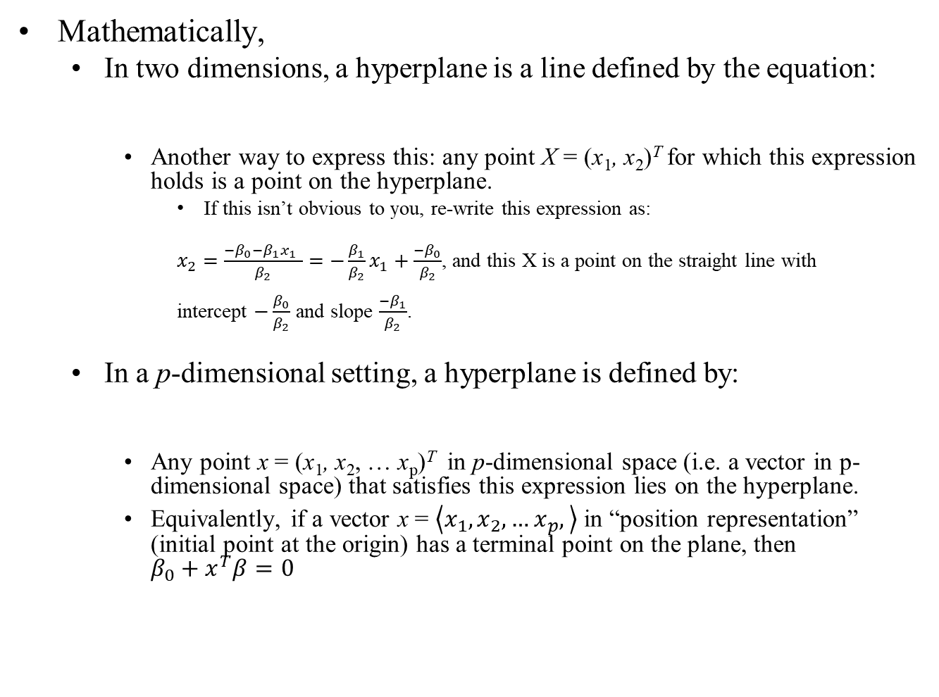


Hyperplanes
Mathematically,
In two dimensions, a hyperplane is a line defined by the equation:
Another way to express this: any point X = (x₁, x₂)^{T} for which this expression holds is a point on the hyperplane.
If this isn’t obvious to you, re-write this expression as:
$x_{2}=\frac{−β_{0}−β_{1}x_{1} }{β_{2}}=−\frac{β_{1}}{β_{2}}x_{1}+\frac{−β_{0}}{β_{2}}$, and this X is a point on the straight line with intercept $−\frac{β_{0}}{β_{2}}$ and slope $\frac{−β_{1}}{β_{2}}$.
In a p-dimensional setting, a hyperplane is defined by:
Any point x = (x₁, x₂, … x_{p})^{T} in p-dimensional space (i.e. a vector in p-dimensional space) that satisfies this expression lies on the hyperplane.
Equivalently, if a vector x = $\left\langle x_{1},x_{2}, …x_{p},\right\rangle$ in “position representation” (initial point at the origin) has a terminal point on the plane, then ${β_{0}+x}^{T}β=0$
$$β_{0}+β_{1}x_{1}+β_{2}x_{2}=0$$
$$β_{0}+β_{1}x_{1}+β_{2}x_{2}+…+β_{p}x_{p}=0$$
Notes:
Just move B2x2 to rhs and divide by B2

Slide 7


Hyperplanes
Suppose that X does not satisfy this expression; rather,
Then this tells us that X lies to one side of the hyperplane, say “above”.
Alternatively, if then X lies on the other side of the hyperplane, say “below”.
So we can think of the hyperplane as dividing p-dimensional space into two halves.
One can easily determine on which side of the hyperplane a point lies by simply calculating the sign of the left hand side.
$$β_{0}+β_{0}x_{1}+β_{2}x_{2}+…+β_{p}x_{p}>0$$
$$β_{0}+β_{0}x_{1}+β_{2}x_{2}+…+β_{p}x_{p}<0$$

Slide 8
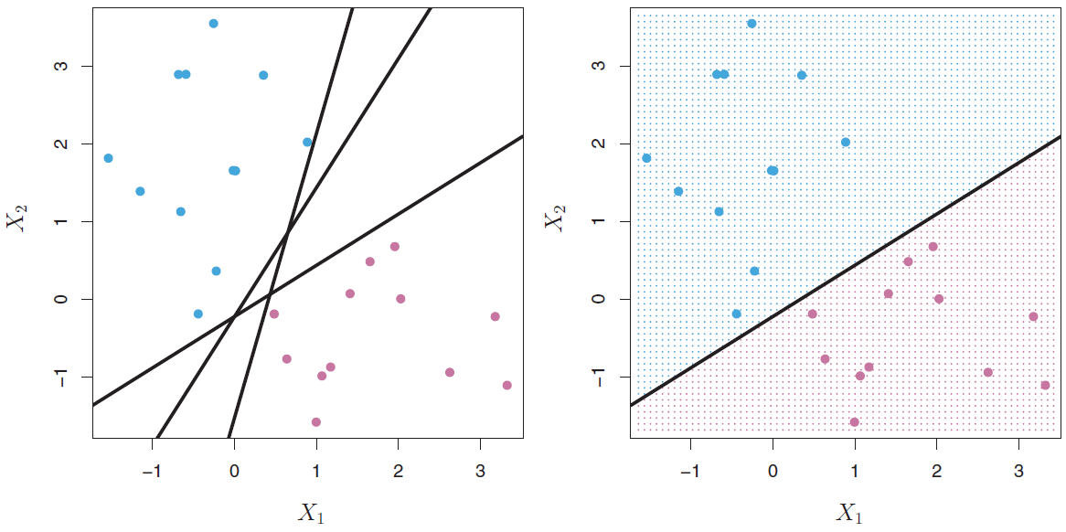
Hyperplanes
The hyperplane 1 + 2x₁ + 3x₂ = 0 is shown.
The blue region is the set of points for which 1+2x₁ +3x₂ > 0
The purple region is the set of points for which 1 + 2x₁ +3x₂ < 0

Slide 9
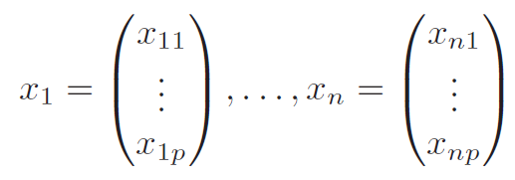
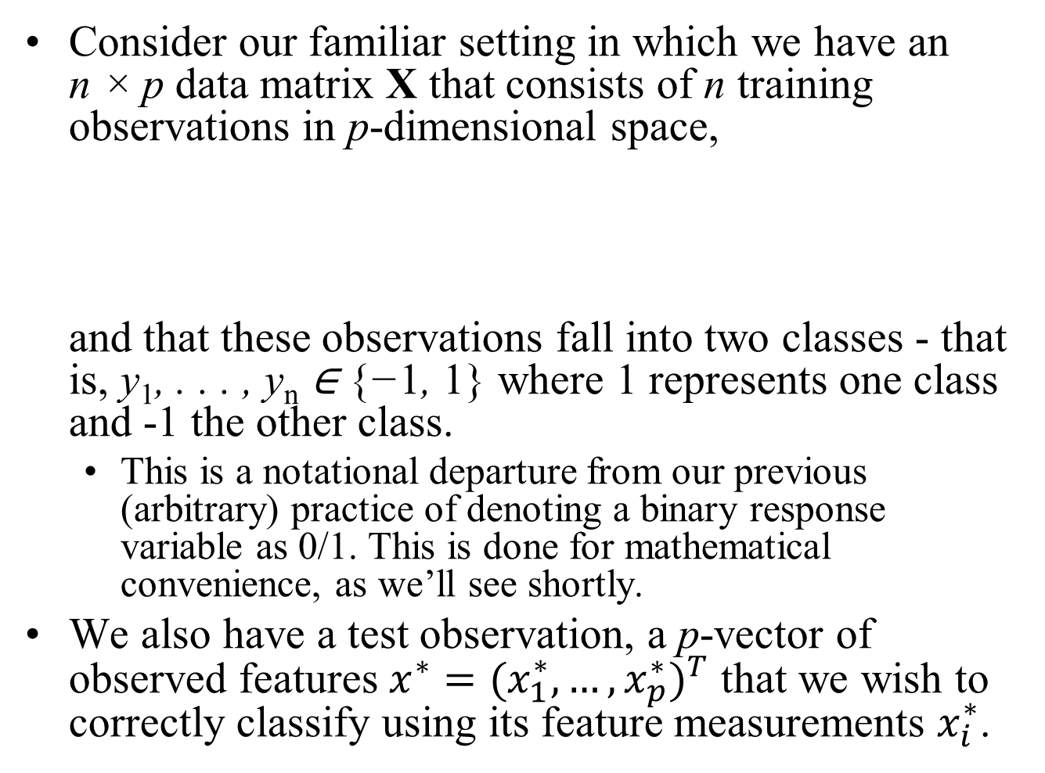
Classification Using a Separating Hyperplane
Consider our familiar setting in which we have an n × p data matrix X that consists of n training observations in p-dimensional space, and that these observations fall into two classes - that is, y₁, . . . , y_{n} ∈ {−1, 1} where 1 represents one class and -1 the other class.
This is a notational departure from our previous (arbitrary) practice of denoting a binary response variable as 0/1. This is done for mathematical convenience, as we’ll see shortly.
We also have a test observation, a p-vector of observed features $x^{∗}={(x_{1}^{∗},…,x_{p}^{∗})}^{T}$ that we wish to correctly classify using its feature measurements $x_{i}^{∗}$.

Slide 10
Classification Using a Separating Hyperplane
We have seen a number of approaches for this task, such as KNN, Bernoulli Naïve Bayes, Logistic Regression , LDA, QDA, and Ridge and Lasso Classification.
We will now see a new approach that is based upon the concept of a separating hyperplane.

Slide 11
Classification Using a Separating Hyperplane
y = 1 for these points
y = -1 for these points
Suppose that it is possible to construct a hyperplane that separates the training observations perfectly according to their class labels.
Examples of three such separating hyperplanes are shown in the left-hand panel above.
We have labeled the observations from the blue class as y_{i} = 1 and those from the purple class as y_{i} = −1.

Slide 12
Classification Using a Separating Hyperplane
y = 1 for these points
y = -1 for these points
Then a separating hyperplane has the properties and
Equivalently, a Separating Hyperplane has the property that for all i in 1,…, n with x_{i} not on the hyperplane.
$$β_{0}+β_{1}x_{i1}+β_{2}x_{i2}+…+β_{p}x_{ip}>0 iff y_{i}=1,$$
$β_{0}+β_{1}x_{i1}+β_{2}x_{i2}+…+β_{p}x_{ip}<0 iff y_{i}=−1$.
$${y_{i}(β}_{0}+β_{1}x_{i1}+β_{2}x_{i2}+…+β_{p}x_{ip})>0$$
This is where the mathematical convenience comes in.

Slide 13
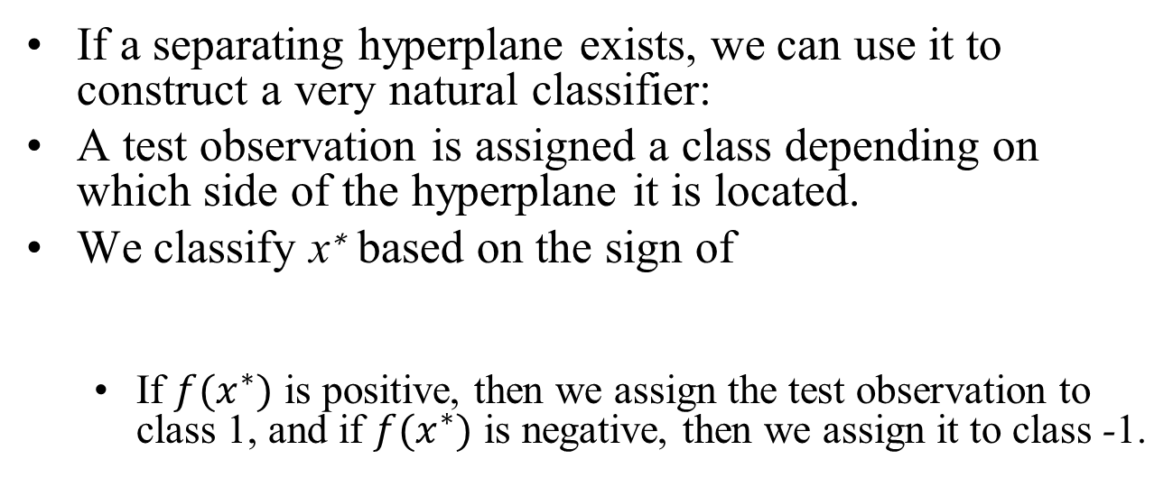
Classification Using a Separating Hyperplane
If a separating hyperplane exists, we can use it to construct a very natural classifier:
A test observation is assigned a class depending on which side of the hyperplane it is located.
We classify x∗ based on the sign of
If $f(x^{∗})$ is positive, then we assign the test observation to class 1, and if $f(x^{∗})$ is negative, then we assign it to class -1.
$$f\left(x^{∗}\right)=β_{0}+β_{1}x_{1}^{∗}+β_{2}x_{2}^{∗}+…+β_{p}x_{p}^{∗}$$

Slide 14
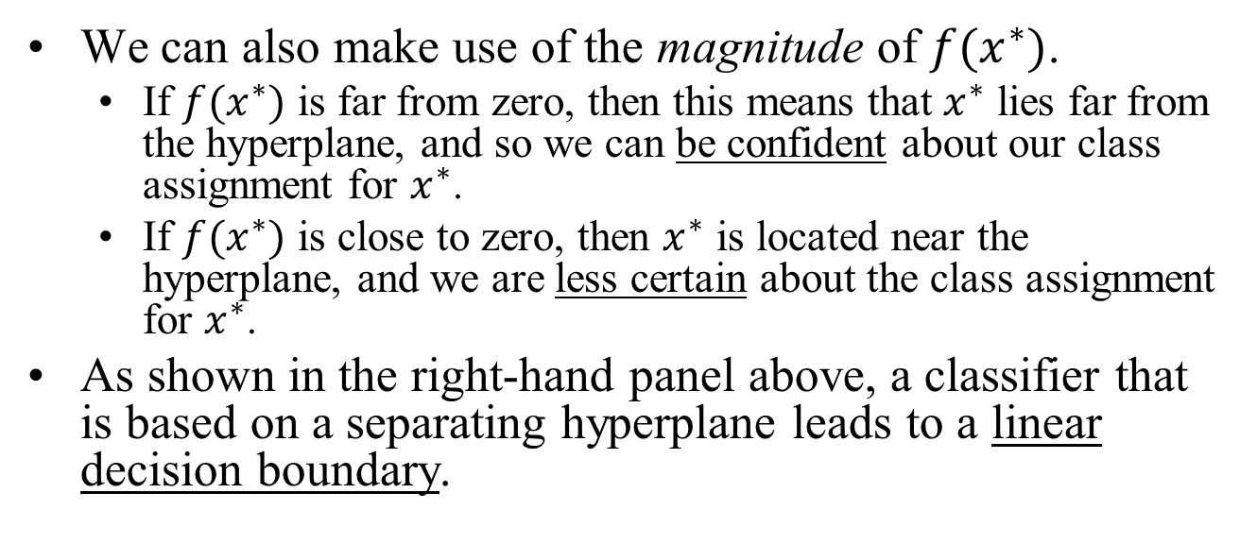
Classification Using a Separating Hyperplane
We can also make use of the magnitude of $f(x^{∗})$.
If $f(x^{∗})$ is far from zero, then this means that $x^{∗}$ lies far from the hyperplane, and so we can be confident about our class assignment for $x^{∗}$.
If $f(x^{∗})$ is close to zero, then $x^{∗}$ is located near the hyperplane, and we are less certain about the class assignment for $x^{∗}$.
As shown in the right-hand panel above, a classifier that is based on a separating hyperplane leads to a linear decision boundary.

Slide 15
Classification Using a Separating Hyperplane
In general, if our data can be perfectly separated using a hyperplane, then there will in fact exist an infinite number of such hyperplanes.
This is because a given separating hyperplane can usually be shifted a tiny bit up or down, or rotated, without coming into contact with any of the observations.
Three possible separating hyperplanes are shown in the left-hand panel above.
In order to construct a classifier based upon a separating hyperplane, we must have a reasonable way to decide which of the infinite possible separating hyperplanes to use.

Slide 16
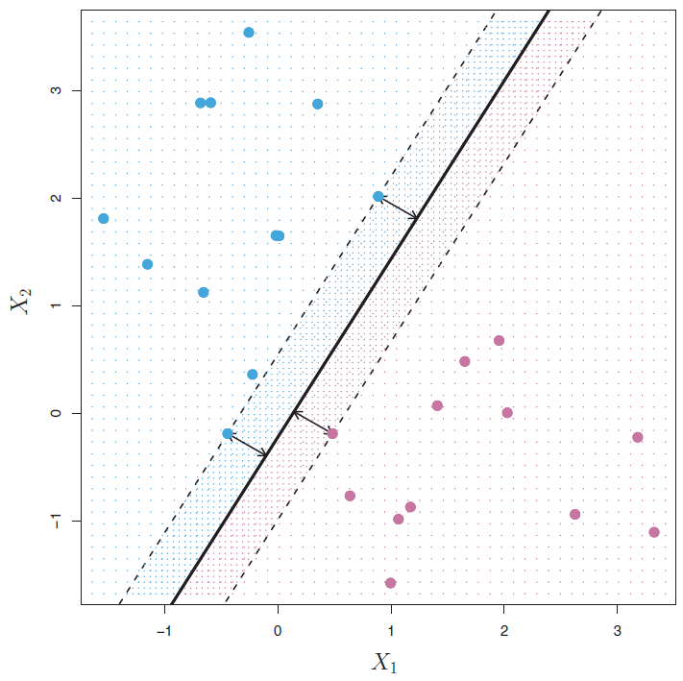
The Maximal Margin Classifier
The Maximal Margin Hyperplane is the mid-line of the widest “slab” that we can insert between the two classes
The margin is the
distance from the solid line to either of the dashed lines.
{
Intuitively, the maximal margin hyperplane (also known as the optimal separating hyperplane), is the separating hyperplane that is farthest from the training observations.
To determine which of the candidate separating hyperplanes is the maximal margin hyperplane, we proceed as follows:
For each separating hyperplane, compute the distance from each training observation to that hyperplane; the smallest such distance is known as the margin for that hyperplane.
The maximal margin hyperplane is the separating hyperplane for which the margin is largest - that is, it is the hyperplane that has the farthest minimum distance to the training observations.

Slide 17
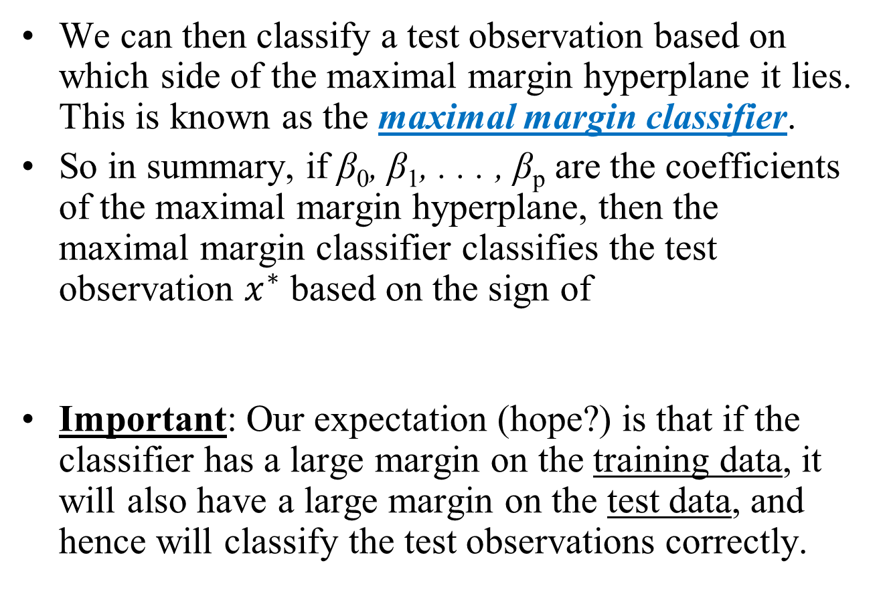
The Maximal Margin Classifier
We can then classify a test observation based on which side of the maximal margin hyperplane it lies. This is known as the maximal margin classifier.
So in summary, if β₀, β₁, . . . , β_{p} are the coefficients of the maximal margin hyperplane, then the maximal margin classifier classifies the test observation $x^{∗}$ based on the sign of
Important: Our expectation (hope?) is that if the classifier has a large margin on the training data, it will also have a large margin on the test data, and hence will classify the test observations correctly.
$$f\left(x^{∗}\right)=β_{0}+β_{1}x_{1}^{∗}+β_{2}x_{2}^{∗}+…+β_{p}x_{p}^{∗}$$

Slide 18
The Maximal Margin Classifier
The Maximal Margin Hyperplane is the mid-line of the widest “slab” that we can insert between the two classes
The Support Vectors
The margin is the
distance from the solid line to either of the dashed lines
{
Observe that three training observations are equidistant from the maximal margin hyperplane and lie along the dashed lines indicating the width of the margin.
These three observations are known as support vectors, since they are vectors in p-dimensional space (here p = 2) and they “support” the maximal margin hyperplane in the sense that if these points were moved slightly then the maximal margin hyperplane would move as well.

Slide 19
The Maximal Margin Classifier
The Maximal Margin Hyperplane is the mid-line of the widest “slab” that we can insert between the two classes
The Support Vectors
The margin is the
distance from the solid line to either of the dashed lines
{
Note that the maximal margin hyperplane depends directly on the support vectors, but not on the other observations.
A movement to any of the other observations would not affect the separating hyperplane, provided that the observation’s movement does not cause it to cross the boundary set by the margin.
The fact that the maximal margin hyperplane depends directly on only a small subset of the observations is an important property that will arise later when we discuss the support vector classifier and support vector machines.

Slide 20
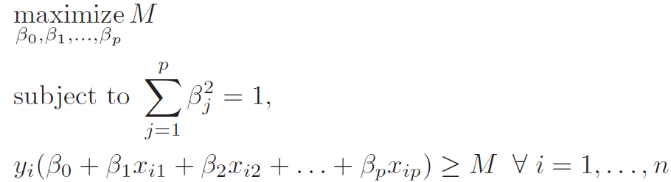
Construction of the Maximal Margin Classifier
To find the maximal margin hyperplane, we solve the following optimization problem:
This is perhaps simpler than it looks:
The last constraint guarantees that each observation will be on the correct side of the hyperplane with some “cushion” (i.e. margin) M, provided that M is positive.

Slide 21
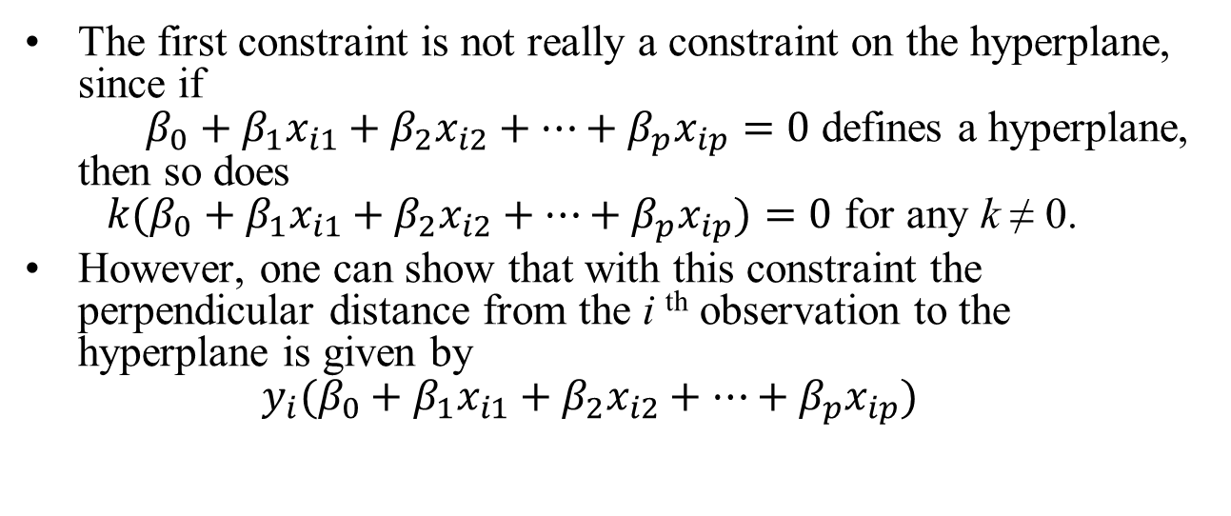
Construction of the Maximal Margin Classifier
The first constraint is not really a constraint on the hyperplane, since if $β_{0}+β_{1}x_{i1}+β_{2}x_{i2}+…+β_{p}x_{ip}=0$ defines a hyperplane, then so does ${k(β}_{0}+β_{1}x_{i1}+β_{2}x_{i2}+…+β_{p}x_{ip})=0$ for any k ≠ 0.
However, one can show that with this constraint the perpendicular distance from the i ^{th} observation to the hyperplane is given by ${y_{i}(β}_{0}+β_{1}x_{i1}+β_{2}x_{i2}+…+β_{p}x_{ip})$
Notes:
See notes for 2 solutions (algebra and vectors)
Bullet 1:If b1 and b2 are initial betas, multiply each by 1/sqrt(b1^2 + b2^2), square each and add then up – results in 1. So multiple all 3 betas (i.e., including b0) by the same factor to insure all points remain on the line (i.e satisfies the plane equation).
Bullet 2: Just plug the def’s of slope and intercept into expression for perp. distance between point and line (see spreadsheet note)

Slide 22
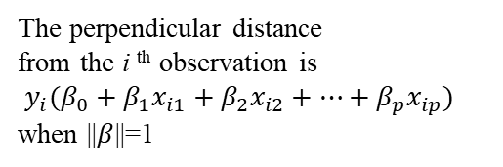
Construction of the Maximal Margin Classifier
The perpendicular distance from the i ^{th} observation is ${y_{i}(β}_{0}+β_{1}x_{i1}+β_{2}x_{i2}+…+β_{p}x_{ip})$
when ||$β$||=1
The Support Vectors
{
The margin
{
Therefore, taken together, the two constraints ensure that each observation is on the correct side of the hyperplane and at least a distance M from the hyperplane.
Hence, M represents the margin of our hyperplane, and the optimization problem chooses β₀, β₁, . . . , β_{p} to maximize M.

Slide 23



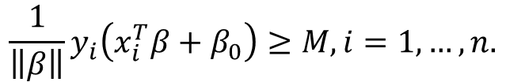

Solution Note for the Maximal Margin Classifier
$$\max_{β,β_{0}}{M}$$
subject to
$$\left\|β\right\|=1, and$$
$$y_{i}\left(x_{i}^{T}β+β_{0}\right)≥M,i=1,…,n.$$
Above is our earlier expression of the optimization problem, expressed in vector form for convenience.
The two constraints ensure that all the points are at least a distance M from the decision boundary defined by β and β₀, and we seek the largest such M.
There is another slightly different formulation of this problem, which is more commonly seen in the literature.
We can get rid of the first constraint by replacing the second constraint with
…or equivalently
$${\frac{1}{\left\|β\right\|}y}_{i}\left(x_{i}^{T}β+β_{0}\right)≥M,i=1,…,n.$$
$$y_{i}\left(x_{i}^{T}β+β_{0}\right)≥M\left\|β\right\|,i=1,…,n.$$

Slide 24



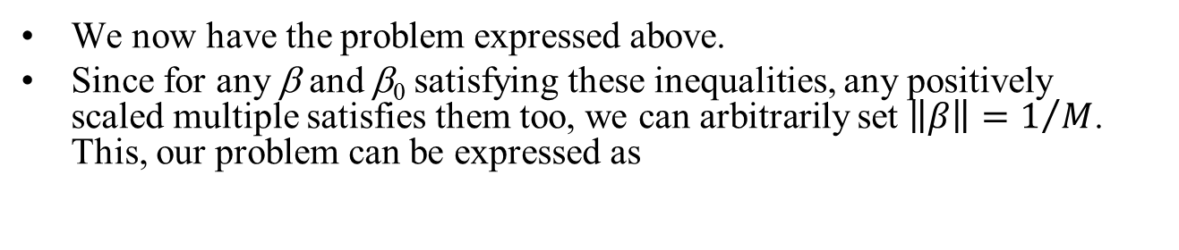



Solution Note for the Maximal Margin Classifier
$$\max_{β,β_{0}}{M}$$
subject to
$$y_{i}\left(x_{i}^{T}β+β_{0}\right)≥M\left\|β\right\|,i=1,…,n.$$
We now have the problem expressed above.
Since for any β and β₀ satisfying these inequalities, any positively scaled multiple satisfies them too, we can arbitrarily set $\left\|β\right\|=1/M$. This, our problem can be expressed as
$$\min_{β,β_{0}}\left\|β\right\|$$
subject to
$$y_{i}\left(x_{i}^{T}β+β_{0}\right)≥1,i=1,…,n.$$
Any β and β₀ that satisfies this expression also satisfies the following:
$$\min_{β,β_{0}}{{\frac{1}{2}\left\|β\right\|}^{2}}$$
subject to
$$y_{i}\left(x_{i}^{T}β+β_{0}\right)≥1,i=1,…,n.$$

Slide 25
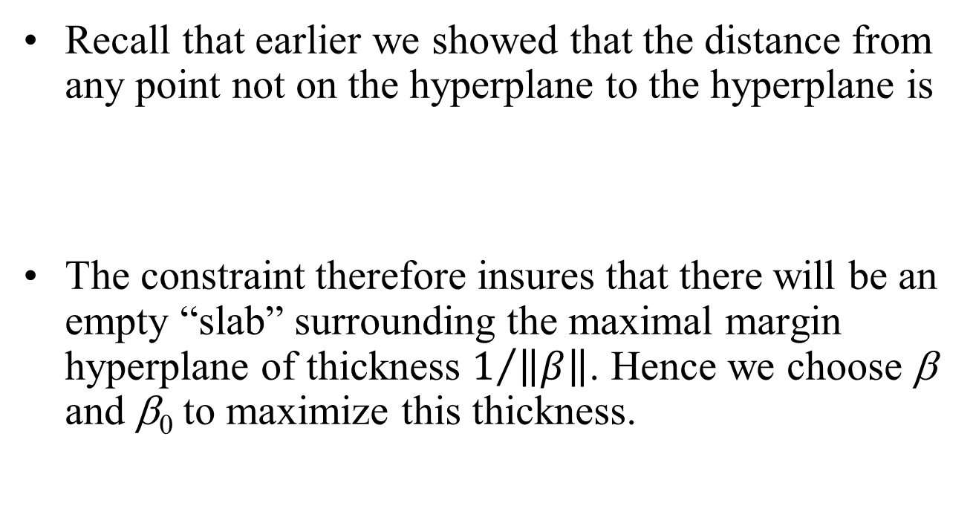
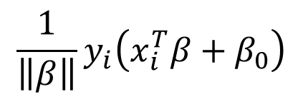

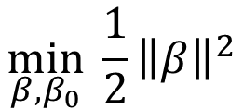
Solution Note for the Maximal Margin Classifier
$$\min_{β,β_{0}}{{\frac{1}{2}\left\|β\right\|}^{2}}$$
subject to
$$y_{i}\left(x_{i}^{T}β+β_{0}\right)≥1,i=1,…,N.$$
Recall that earlier we showed that the distance from any point not on the hyperplane to the hyperplane is
The constraint therefore insures that there will be an empty “slab” surrounding the maximal margin hyperplane of thickness $1/{\left\|β\right\|}$. Hence we choose β and β₀ to maximize this thickness.
$${\frac{1}{\left\|β\right\|}y}_{i}\left(x_{i}^{T}β+β_{0}\right)$$
Notes:
This is a quadratic optimization problem that can be solved using readily available software (QP for quadratic programming). However, there’s a better way…

Slide 26

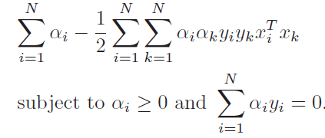
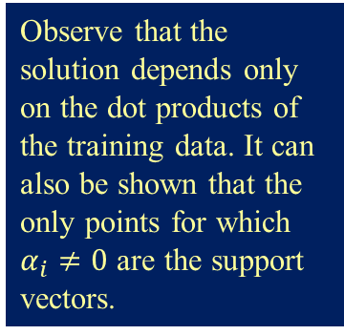
Solution Note for the Maximal Margin Classifier
This is a convex quadratic optimization problem. The Lagrangian for the primal function to be minimized w.r.t. α, β and β₀, is
Setting the partial derivatives equal to 0, solving for β, and substituting back into L_{P}, we obtain we obtain the dual optimization problem
Observe that the solution depends only on the dot products of the training data. It can also be shown that the only points for which $α_{i}≠0$ are the support vectors.
max_{α}

Slide 27
Solution Note for the Maximal Margin Classifier
max_{α}
In the dual problem above, we have a maximization problem with the parameters the α_{i}’s, which is much easier to solve than the earlier quadratic optimization problem.
Once we have found the α_{i}’s, we can go back and substitute these into the partial derivative expressions to find the optimal betas as a function of the α_{i}’s.

Slide 28
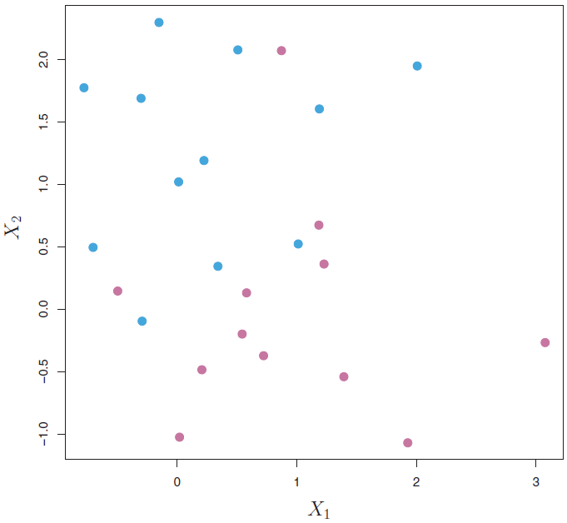
But What If Our Data Looks Like This?
x
x
x

Slide 29
The Non-separable Case
The maximal margin classifier is a very natural way to perform classification, if a separating hyperplane exists.
However, in most cases no separating hyperplane exists, and so there is no maximal margin classifier (and the optimization problem just discussed has no solution).
In this case, we cannot exactly separate the two classes.
However, we can extend the concept of a separating hyperplane in order to develop a hyperplane that almost separates the classes, using a so-called soft margin.
The generalization of the maximal margin classifier to the non-separable case is known as the Support Vector Classifier.

Slide 30
Support vector classifier

Slide 31
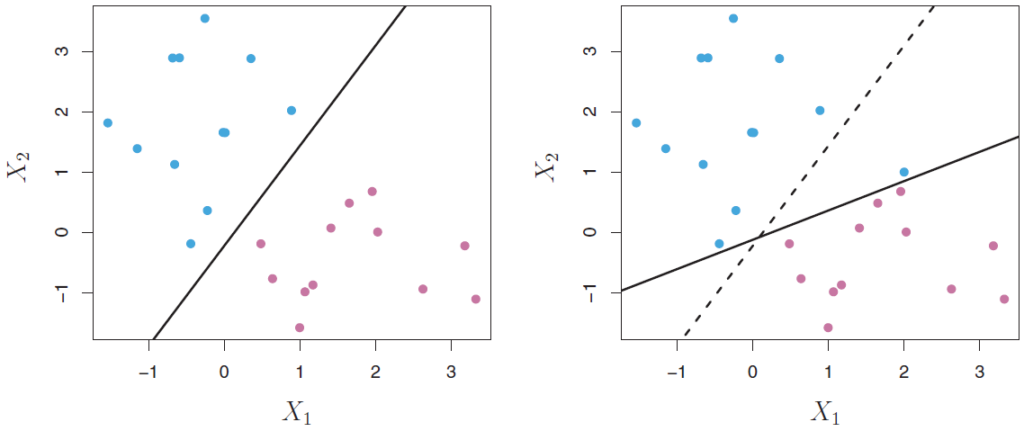
Overview
The addition of one additional point dramatically changes the maximal margin hyperplane
There are instances in which a classifier based on a separating hyperplane, even if it exists, might not be desirable.
A classifier based on a separating hyperplane will necessarily perfectly classify all of the training observations; this can lead to sensitivity to individual observations.
In the example above, the addition of a single observation in the right-hand panel leads to a dramatic change in the maximal margin hyperplane.

Slide 32
Overview
The addition of one additional point dramatically changes the maximal margin hyperplane
The resulting maximal margin hyperplane is not satisfactory for two reasons:
It has only a tiny margin. This is problematic because as discussed previously, the distance of an observation from the hyperplane can be seen as a measure of our confidence that the observation was correctly classified.
The fact that the maximal margin hyperplane is extremely sensitive to a change in a single observation suggests that it may have overfit the training data.

Slide 33
Overview
In this case, we might be willing to consider a classifier based on a hyperplane that does not perfectly separate the two classes, in the interest of
Greater robustness to individual observations
Better classification of most of the training observations
That is, it could be worthwhile to misclassify a few training observations in order to do a better job in classifying the remaining observations.

Slide 34
Overview
The support vector classifier, sometimes called a soft margin classifier, does exactly this.
Rather than seeking the largest possible margin so that every observation is both on the correct side of the hyperplane and also on the correct side of the margin, we instead allow some observations to be on the incorrect side of the margin, or even the incorrect side of the hyperplane (thus the term “soft”).

Slide 35
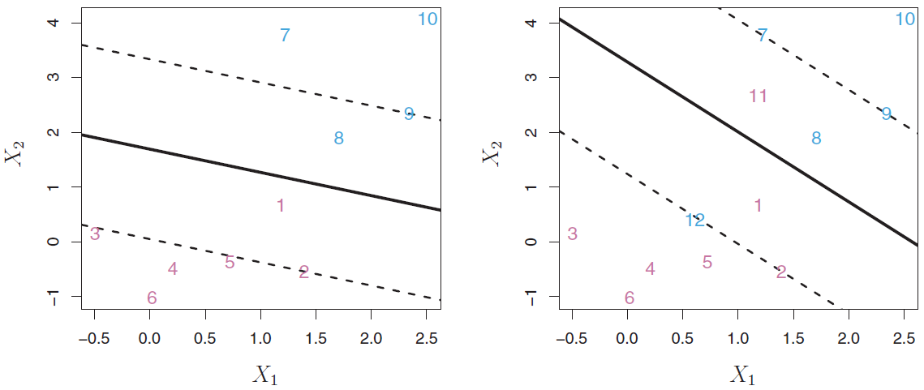
Overview
Correct side of the hyperplane, correct side of the margin
Correct side of the hyperplane, wrong side of the margin
Support vectors (on the margin)
Example:
Left panel: All points are on the correct side of the hyperplane, and all but two are on the correct side of the margin.
However, an observation can be not only on the wrong side of the margin, but also on the wrong side of the hyperplane.
In fact, when there is no separating hyperplane, such a situation is inevitable.
Right panel: Observations on the wrong side of the hyperplane correspond to training observations that are misclassified by the support vector classifier. Points 11 and 12 are misclassified.

Slide 36
Overview
Correct side of the hyperplane, correct side of the margin
Correct side of the hyperplane, wrong side of the margin
Wrong side of the hyperplane (so misclassified)
Support vectors (on the margin)
Example:
Left panel: All points are on the correct side of the hyperplane, and all but two are on the correct side of the margin.
However, an observation can be not only on the wrong side of the margin, but also on the wrong side of the hyperplane.
In fact, when there is no separating hyperplane, such a situation is inevitable.
Right panel: Observations on the wrong side of the hyperplane correspond to training observations that are misclassified by the support vector classifier
Points 11 and 12 are misclassified.

Slide 37
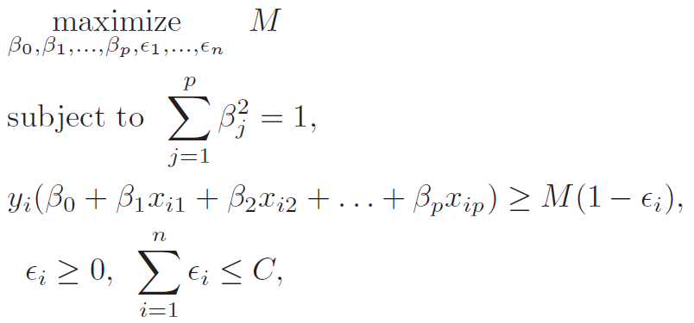
Details of the Support Vector Classifier
We wish to choose a hyperplane that correctly separates most of the training observations into the two classes, but may misclassify a few observations.
To find such a hyperplane, we solve the above optimization problem.

Slide 38
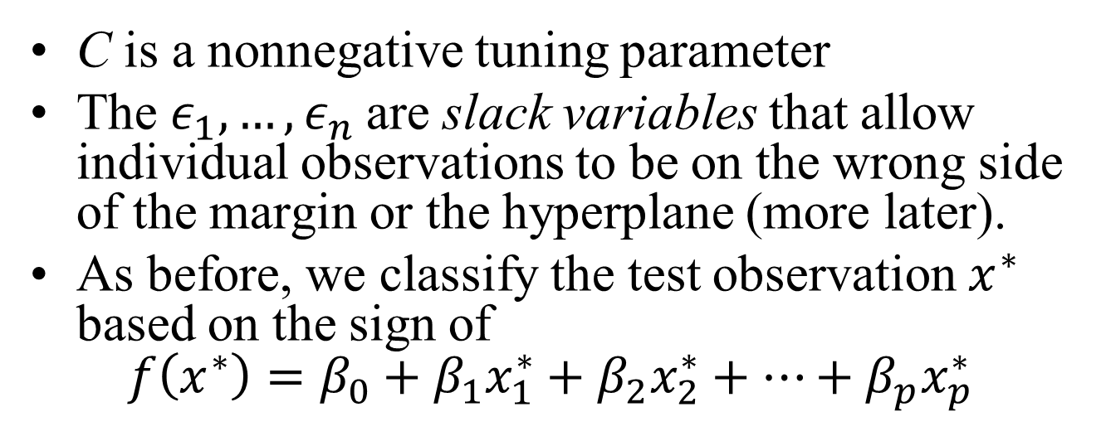
Details of the Support Vector Classifier
Changes to the maximal margin classifier constraints
C is a nonnegative tuning parameter
The $ε_{1},…,ε_{n}$are slack variables that allow individual observations to be on the wrong side of the margin or the hyperplane (more later).
As before, we classify the test observation $x^{∗}$ based on the sign of $f\left(x^{∗}\right)=β_{0}+β_{1}x_{1}^{∗}+β_{2}x_{2}^{∗}+…+β_{p}x_{p}^{∗}$

Slide 39
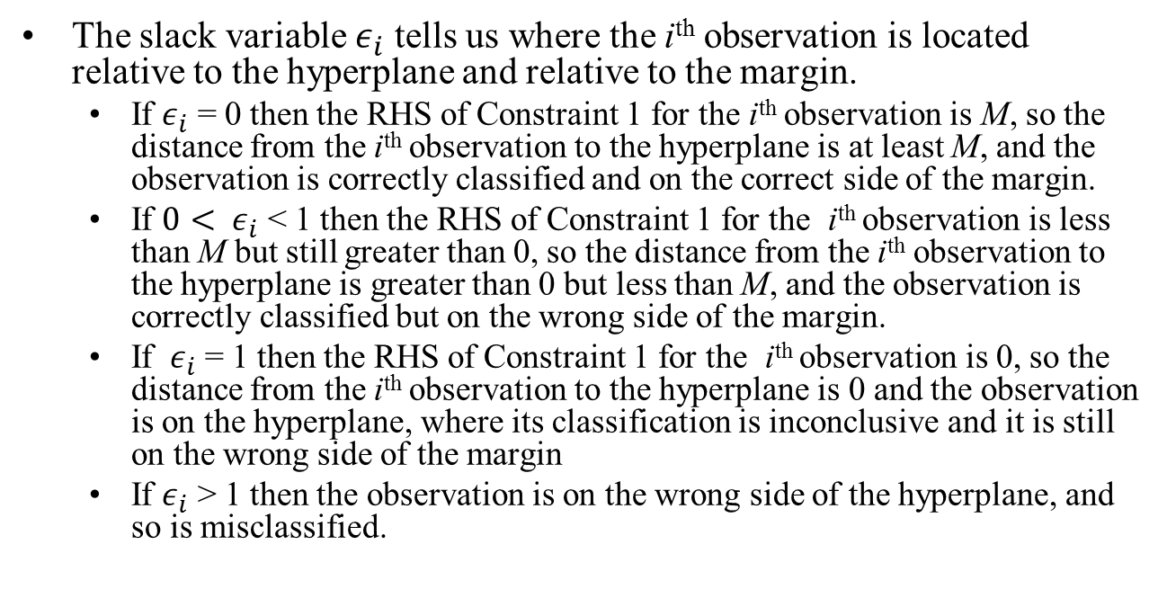
Details of the Support Vector Classifier
(Constraint 1)
(Constraint 2)
The slack variable $ε_{i}$ tells us where the i^{th} observation is located relative to the hyperplane and relative to the margin.
If $ε_{i}$ = 0 then the RHS of Constraint 1 for the i^{th} observation is M, so the distance from the i^{th} observation to the hyperplane is at least M, and the observation is correctly classified and on the correct side of the margin.
If ${0< ε}_{i}$ < 1 then the RHS of Constraint 1 for the i^{th} observation is less than M but still greater than 0, so the distance from the i^{th} observation to the hyperplane is greater than 0 but less than M, and the observation is correctly classified but on the wrong side of the margin.
If ${ ε}_{i}$ = 1 then the RHS of Constraint 1 for the i^{th} observation is 0, so the distance from the i^{th} observation to the hyperplane is 0 and the observation is on the hyperplane, where its classification is inconclusive and it is still on the wrong side of the margin
If $ε_{i}$ > 1 then the observation is on the wrong side of the hyperplane, and so is misclassified.

Slide 40
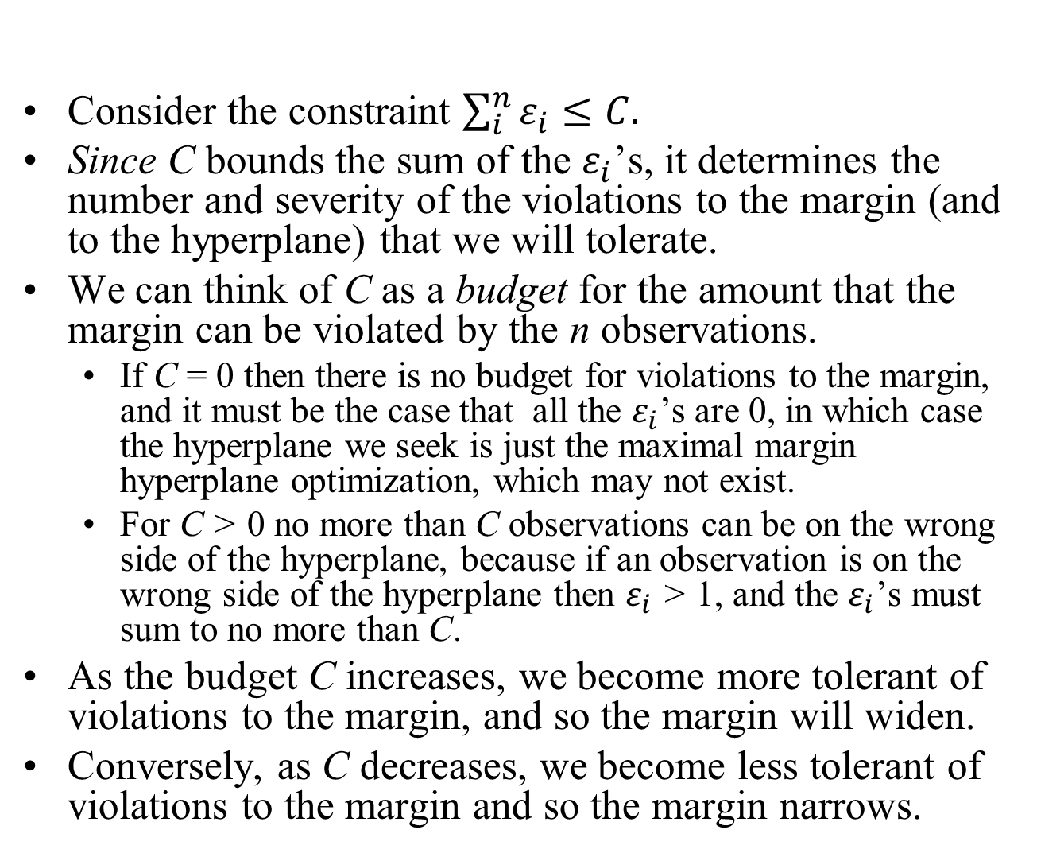
Details of the Support Vector Classifier
Consider the constraint $\sum_{i}^{n}{ε_{i}≤C.}$
Since C bounds the sum of the $ε_{i}$’s, it determines the number and severity of the violations to the margin (and to the hyperplane) that we will tolerate.
We can think of C as a budget for the amount that the margin can be violated by the n observations.
If C = 0 then there is no budget for violations to the margin, and it must be the case that all the $ε_{i}$’s are 0, in which case the hyperplane we seek is just the maximal margin hyperplane optimization, which may not exist.
For C > 0 no more than C observations can be on the wrong side of the hyperplane, because if an observation is on the wrong side of the hyperplane then $ε_{i}$ > 1, and the $ε_{i}$’s must sum to no more than C.
As the budget C increases, we become more tolerant of violations to the margin, and so the margin will widen.
Conversely, as C decreases, we become less tolerant of violations to the margin and so the margin narrows.

Slide 41
Details of the Support Vector Classifier
Note that only observations that either lie on the margin or that violate the margin will affect the hyperplane, and hence the classifier obtained.
In other words, an observation that lies strictly on the correct side of the margin does not affect the support vector classifier!
Changing the position of that observation would not change the classifier at all, provided that its position remains on the correct side of the margin.
Observations that lie directly on the margin, or on the wrong side of the margin for their class, are known as support vectors. These observations do affect the support vector classifier.

Slide 42
Details of the Support Vector Classifier
The fact that only support vectors affect the classifier implies that C controls the bias-variance trade-off of the support vector classifier.
When the tuning parameter C is large, then the margin is wide, many observations violate the margin, and so there are many support vectors.
In this case, many observations are involved in determining the hyperplane.

Slide 43
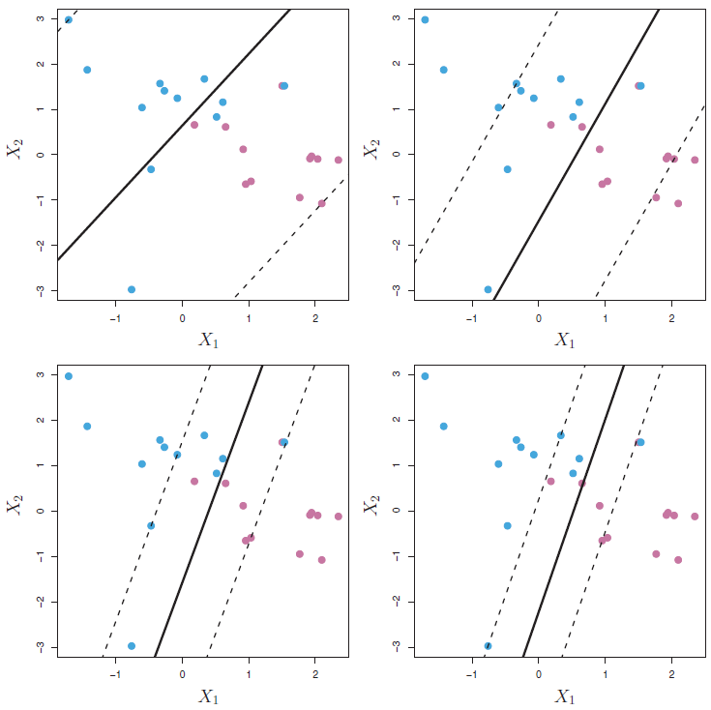
Details of the Support Vector Classifier
The largest value of C was used in the top left panel, and smaller values were used in the other panels.
When C is large, there is a high tolerance for observations being on the wrong side of the margin,
a wider margin, more bias, relatively more support vectors, and lower variance.
As C decreases, the tolerance for observations being on the wrong side of the margin decreases, leading to narrower margins, lower bias, fewer support vectors, and higher variance.

Slide 44

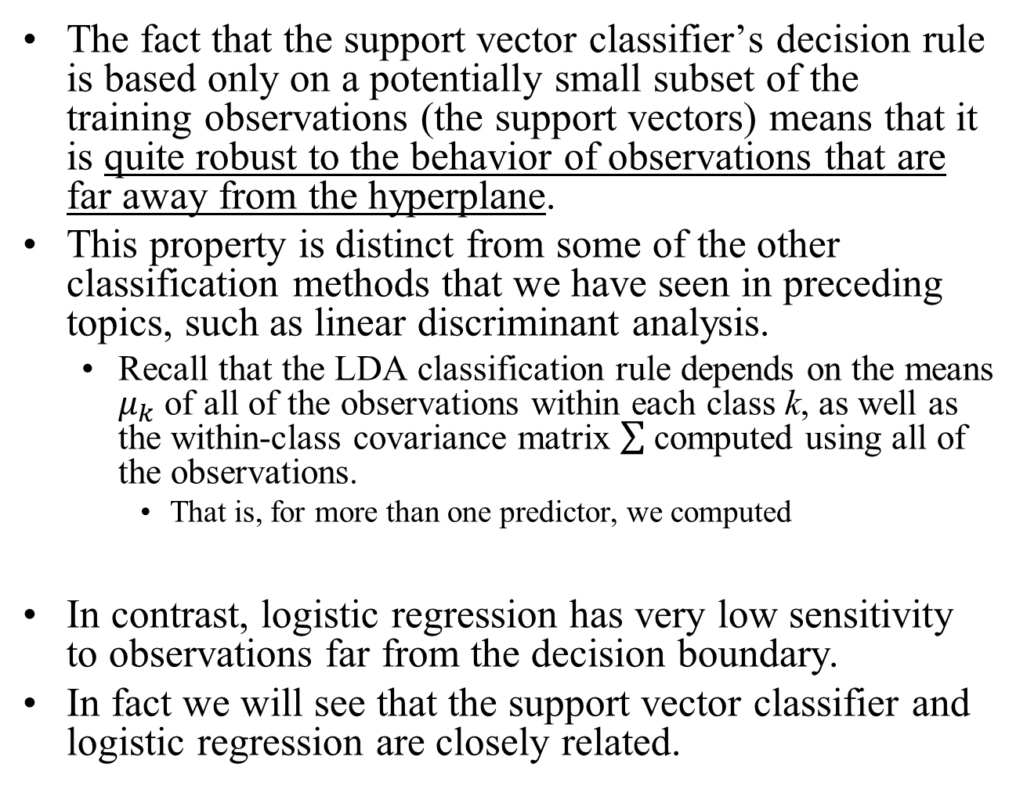
Details of the Support Vector Classifier
The fact that the support vector classifier’s decision rule is based only on a potentially small subset of the training observations (the support vectors) means that it is quite robust to the behavior of observations that are far away from the hyperplane.
This property is distinct from some of the other classification methods that we have seen in preceding topics, such as linear discriminant analysis.
Recall that the LDA classification rule depends on the means $μ_{k}$ of all of the observations within each class k, as well as the within-class covariance matrix computed using all of the observations.
That is, for more than one predictor, we computed
In contrast, logistic regression has very low sensitivity to observations far from the decision boundary.
In fact we will see that the support vector classifier and logistic regression are closely related.

